Slide 1
Sentiment Diversification with Different Biases
Date：2014/04/29
Source：SIGIR’13
Advisor：Prof. Jia-Ling, Koh
Speaker：Wei, Chang

Slide 2
Outline
Introduction
Approach
Framework
Biases
Experiment
Conclusion

Slide 3
Introduction
In previous work diversification has mainly been applied for better topical variety in search results
How can opinionated content exhibiting sentiments be diversified?

Slide 4
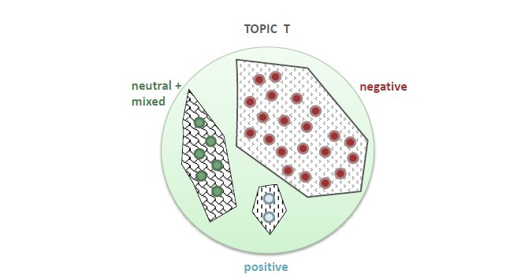
Sentiments
Search for “global warming”
Negative : concern about it and its effects on the environment
Positive : claim that worries about global climate change are unjustified
Neutral : It's a serious problem but we're handling it"
Notes:
Negative : concern about it and its effects on the environment
Positive : claim that worries about global climate change are unjustified
Neutral : It's a serious problem but we're handling it"

Slide 5
3 biases are emphasized in search results
Equal diversification by preferring all sentiments equally.
Diversification towards the Topic Sentiment, in which the resulting reranked list mirrors the actual sentiment bias in a topic.
Diversification against the Topic Sentiment, in which documents about the minority sentiment(s) are boosted whereas those with the majority sentiment are demoted.

Slide 6
Goal
Propose different diversification models for sentiment diversity with 3 biases.

Slide 7
Outline
Introduction
Approach
Frameworks
Retrieval-Interpolated Diversification
Biases
Equal Sentiment Diversification (BAL)
Diversifying Towards the Topic Sentiment (CRD)
Diversifying Against the Topic Sentiment (OTL)
Diversity by Proportionality
Experiment
Conclusion

Slide 8
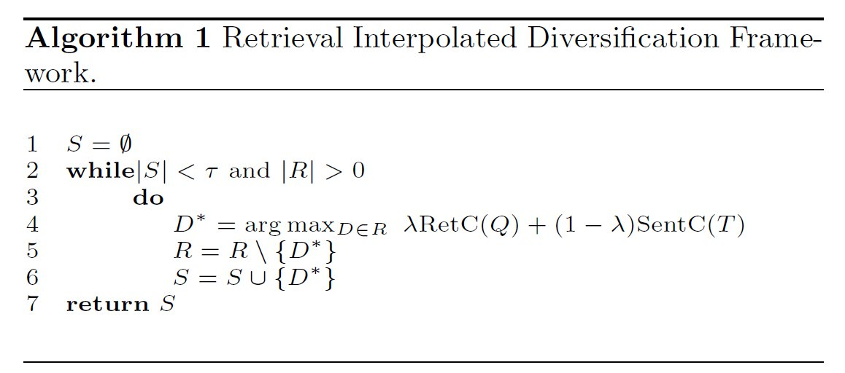
Retrieval-Interpolated Diversification
similar to xQuAD
: retrieval contribution
Q: query
D: a document
S: selected documents
R: retrieved documents
: sentiment contribution

Slide 9
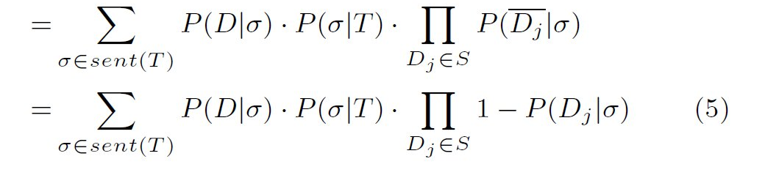
Sentiment Contribution by Strength (SCS)

Slide 10
Sentiment Contribution by Strength and Frequency (SCSF)

Slide 11
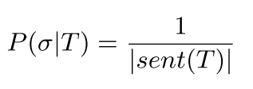
Favoring Different Biases in Search Results
Equal Sentiment Diversification (BAL)
Diversifying Towards the Topic Sentiment (CRD)
Diversifying Against the Topic Sentiment (OTL)
sorted in increasing order of P(σ|T) according to CRD
reverse

Slide 12
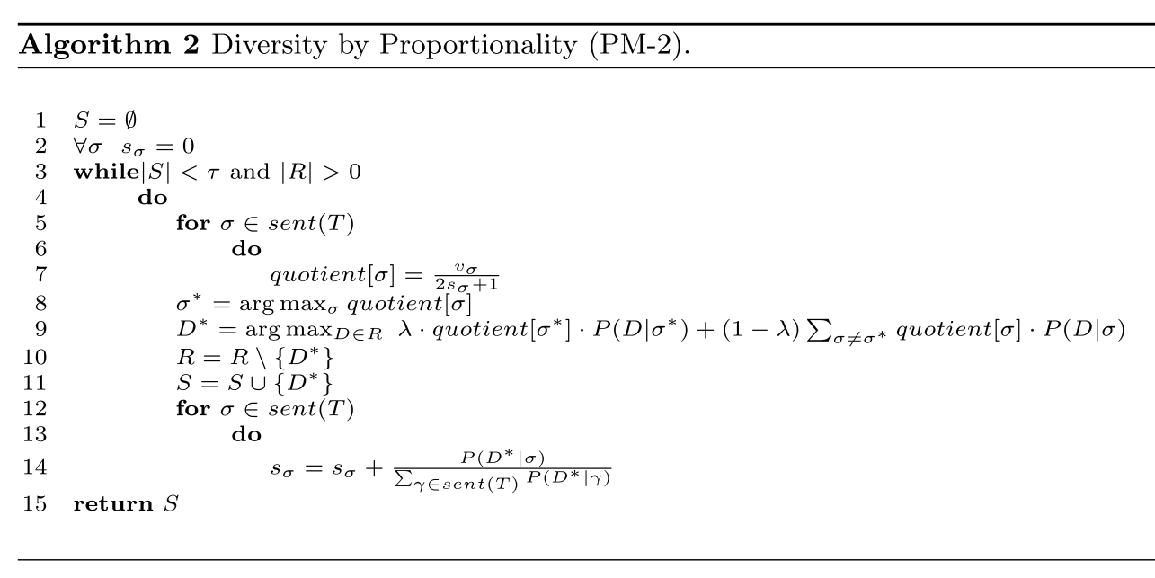
Diversity by Proportionality

Slide 13
PM-2M
lσ, the actual number of documents with senti- ment σ
in the retrieved top K set. For a large enough rank K,
this may result in a suboptimally diversified list where
documents with an over-emphasized sentiment are
exploited early in the ranks.

Slide 14
Outline
Introduction
Approach
Experiment
Conclusion

Slide 15
Evaluation Measure

Slide 16
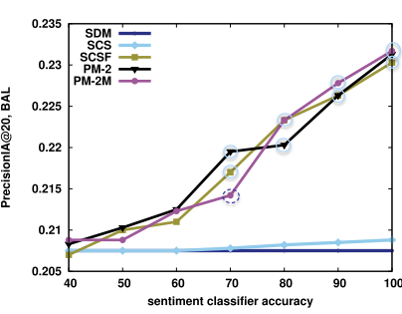
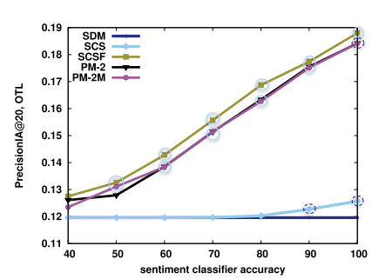
Straight-Bias Experiments

Slide 17
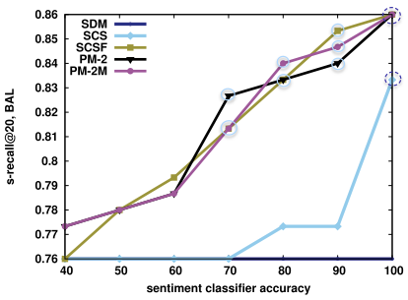
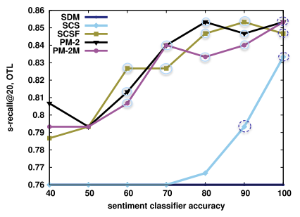
Straight-Bias Experiments

Slide 18
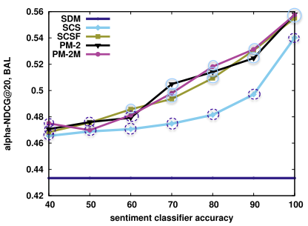
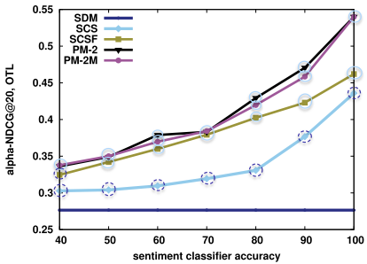
Straight-Bias Experiments

Slide 19
Cross-Bias Experiments Consider

Slide 20
Cross-Bias Experiments Consider

Slide 21
Outline
Introduction
Approach
Experiment
Conclusion

Slide 22
Conclusion
In this paper we demonstrate how to diversify search results according to sentiments by considering a pre-defined bias. This allows us to emphasize either majority or minority sentiments during diversification, or to give an unbiased representation across all sentiment aspects.

